Slide 1
Project Overview
Goal: Utilizing data science techniques to predict risk of heart attack.
Domain: Healthcare
Dataset : "Indicators of Heart Disease (2022 UPDATE)"
Source: CDC's Behavioural Risk Factor Surveillance System (BRFSS). – available at Kaggle
Heart attacks represent a pervasive and critical health challenge globally, necessitating a paradigm shift in risk assessment methodologies.
By analyzing available data and identifying key risk factors, we aim to enhance existing risk assessment practices and support informed decision-making in healthcare.
Current Practices: Framingham Risk Score (FRS), Electronic health records (EHR), Advanced imaging techniques
Rather than replacing current practices, our project seeks to elevate them through meticulous optimization of available data.

Slide 2
The motive of our project is to use data science technique for predicted heart attacks,
The domain that we have selected is healthcare
Dataset is Indicators of heart diseases
Source of dataset is CDC
Framingham Risk Score
It gives output as % risk of getting heart attack 10 years below the line
age, gender, cholesterol levels, blood pressure, smoking status, and diabetes status to calculate the overall risk profile of a patient
Framingham Risk Score has limitations that it relies on static risk factors and the inability to capture dynamic changes in health over time
7.EHR systems allow healthcare providers to track patients' medical history, diagnostic tests, medication usage, and other relevant information.
By analyzing data within EHRs, healthcare professionals can identify individuals with risk factors for heart disease
Disadvantages of EHR is that is not widely used in India or developing countries and only corporate hospital have them ,if you change the hospital you cant have access to EHR due to privacy.
8.Advanced imaging techniques such as CT and MRI imaging
CCTA provides detailed images of the coronary arteries, allowing doctors to assess the presence of plaque buildup or blockages.
Cardiac MRI offers high-resolution images of the heart's structure and function, aiding in the detection of abnormalities such as congenital heart defects.

Slide 3
Background Research
There is a growing need to identify and address critical risk factors associated with heart attack.
Global Statistics
World Heart Federation (WHF)
- Deaths from cardiovascular disease surged 60% globally over the last 30 years
- Every 34 seconds a person dies because of a cardiac disease.
2. In 2022, heart attack cases in India witnessed a concerning increase of 12.5%.
Importance of project
Commercial Value:
Healthcare Providers, Insurers, And Pharmaceutical Companies
Academic Value
Research
Public Health Impact
A Leading Cause of Mortality ,Early Intervention
Cost Reduction
Identifying At-risk Individuals Early
Patient Empowerment
Preventive Measures.

Slide 4
1.Read global stats
Hence we can see that Despite advancements in medical science, we can see that there are gaps in current techniques and actual condition on field
2. So why is this project important?, below are some points
Commercial Value: The project's insights can benefit healthcare providers, insurers, and pharmaceutical companies by informing targeted preventive measures and personalized statistics
Academic Value: The project contributes to academia by advanced understanding in cardiovascular health, providing a basis for further research and new theories in heart attack risk assessment.
Public Health Impact: Heart disease is a leading cause of mortality worldwide as we saw in previous slide. Predicting heart attacks can enable early intervention and potentially save lives.
Cost Reduction: Identifying at-risk individuals early can lead to cost savings for healthcare systems by reducing emergency interventions and hospitalizations.
Patient Empowerment: it can empower individuals to take proactive steps towards heart health through lifestyle changes and preventive measures.
Healthcare experts emphasize the need for increased awareness, preventive measures, and regular health check-ups to curb the rising tide of sudden heart attack deaths.

Slide 5
Complexity Involved
Handling Missing Values:
Addressing gaps in patient data, e.g., cholesterol levels, blood pressure.
Techniques: mean/median imputation, KNN imputation, or simply dropping incomplete entries.
Dealing with Outliers:
Identifying outliers in measurements like heart rate or blood sugar levels.
Methods: Z-score, IQR; deciding to remove or cap them depending on their impact.
Determining Relevant Columns:
Selecting crucial features: age, gender, medical history, lifestyle factors.
Techniques: correlation analysis, Lasso regression, feature importance from models.
Class Balancing:
Handling imbalance in datasets (more healthy patients than those with heart disease).
Techniques: SMOTE, under sampling, class weight adjustment in models.
Classification for Risk Prediction:
Evaluating model performance: focus on metrics like recall (catching actual cases), accuracy, AUC score.
Models to use: Logistic Regression, Random Forest, Gradient Boosting, etc. for predicting risk.

Slide 6
Exploratory Data Analysis
Importing Necessary Libraries and Dataset:
Python libraries used for data handling (e.g., pandas, numpy).
Loading the dataset into the environment.
Dataset Overview:
Total number of rows: 445,132
Total number of columns: 40
Categorical variables: 34
Numeric variables: 6
Duplicate rows: 157 (not dropping these rows)
Handling Missing Values:
Null values present in 38 columns.
Highest percentage of missing values in a column: 18%
Strategies for handling missing values (e.g., imputation, removal).

Slide 7
Redundant columns
Consider removing one of the highly correlated columns to reduce multicollinearity.
Ensure that removing these columns does not lead to loss of significant information for your predictive model.
State, Height in meters, Weight in Kilograms
Alternate sources of data that can supplement the core dataset
Sources:
Previous health records, Lab reports, Medical history, Nutritional Database, Food consumption Survey, Detailed physical activity survey
Columns:
Essential - history of Hypertension, treatment for hypertension, any history of heart disease and durations for all, Cholesterol level
other : Daily calorie consumption, Omega 3 supplements, type of exercises and duration etc.

Slide 8
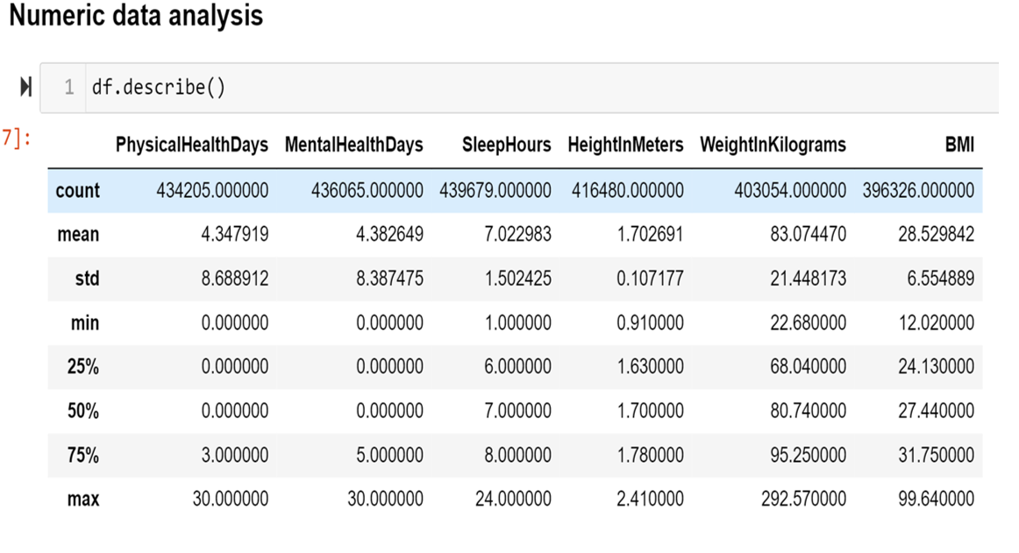
The image you provided shows a table of statistical data analysis results, specifically a summary of descriptive statistics generated by the describe() function in Python’s pandas library. This table includes various health-related variables such as:
PhysicalHealthDays
MentalHealthDays
SleepHours
HeightInMeters
WeightInKilograms
BMI
This type of analysis is useful for understanding the distribution and central tendencies of the data, which can help in identifying patterns and making informed decisions based on the dataset.

Slide 9
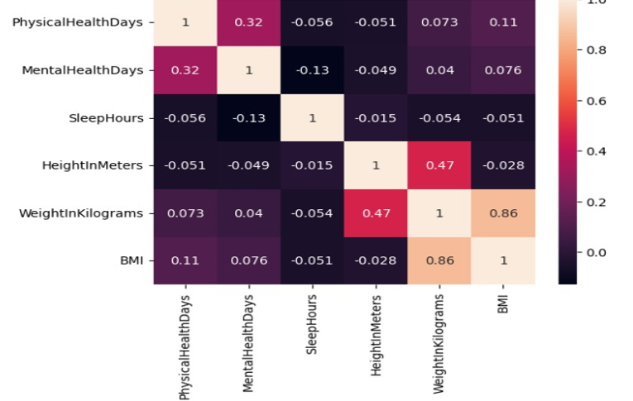
Correlation Matrix for Numeric variables
Observations:
PhysicalHealthDays and MentalHealthDays have a moderate positive correlation (0.32).
HeightInMeters and WeightInKilograms show a strong positive correlation (0.47).
BMI and WeightInKilograms have a very strong positive correlation (0.86).
SleepHours has weak or no significant correlation with other variables.

Slide 10
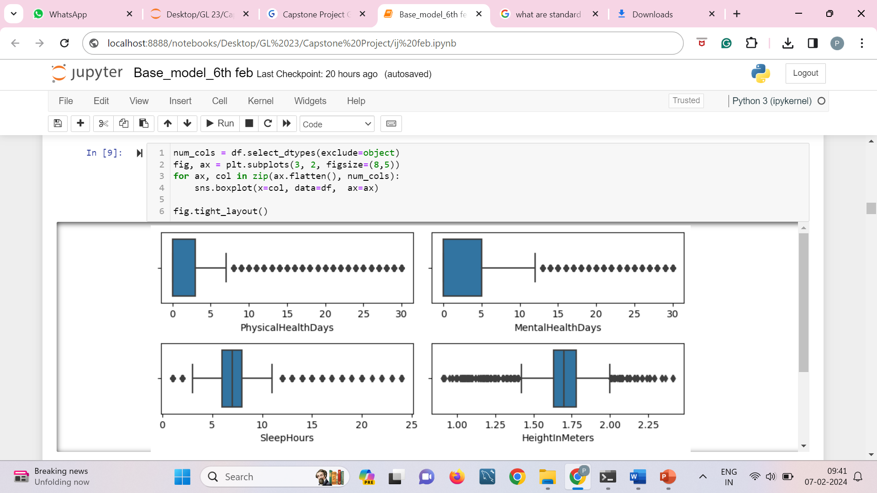
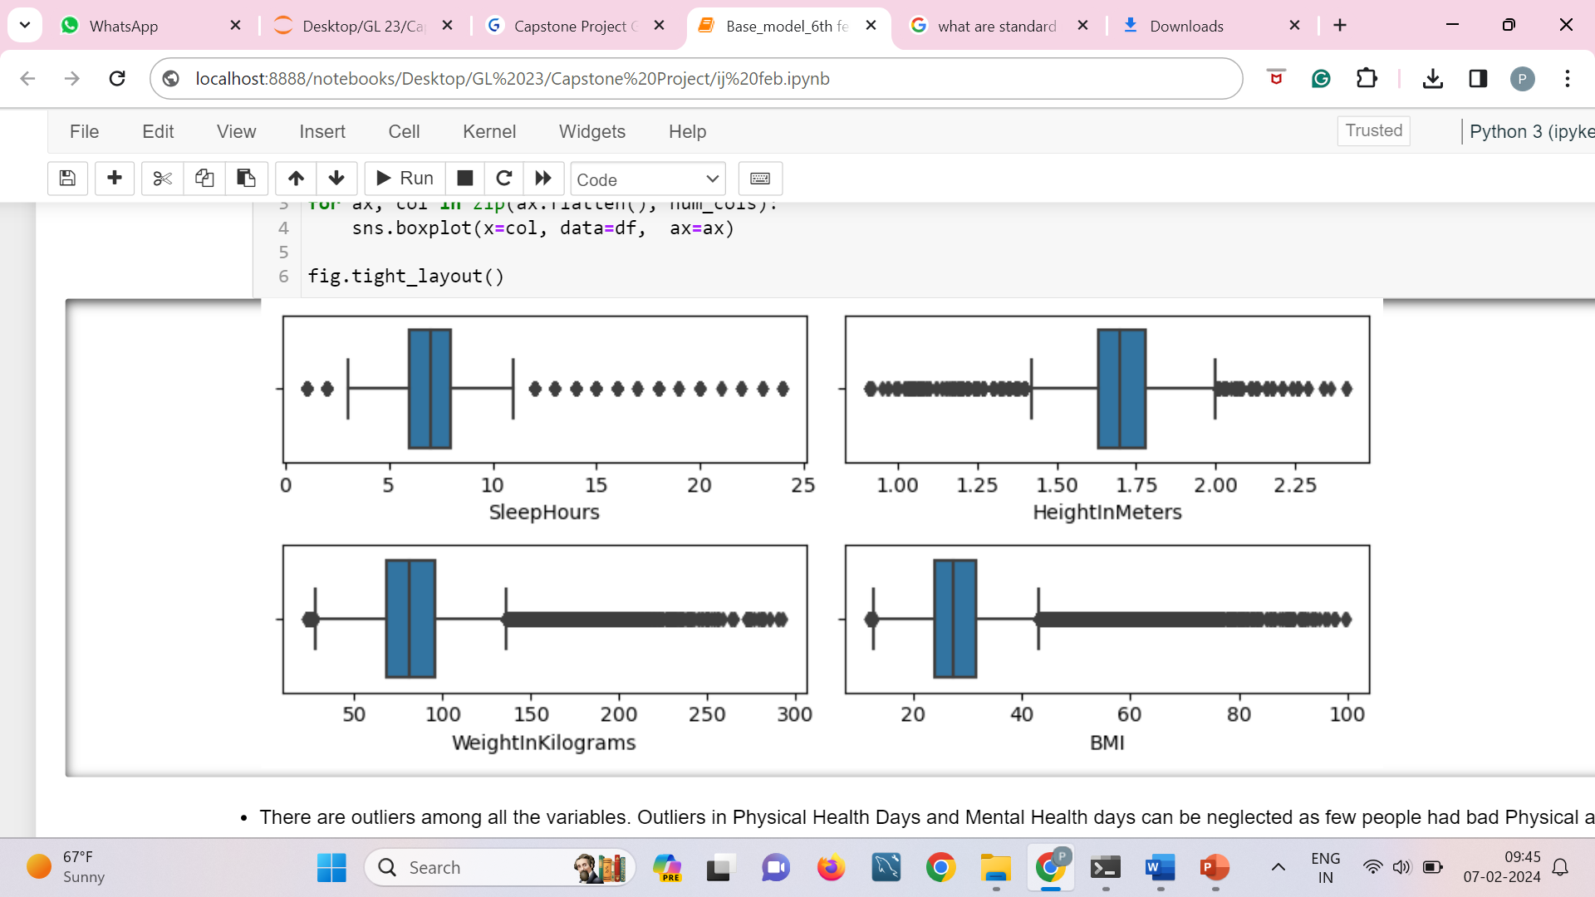
Distribution of Skewness and Outliers in the Dataset
PhysicalHealthDays and MentalHealthDays: Both show a wide range of values with several outliers, indicating variability in the number of days people experience physical and mental health issues.
SleepHours: The majority of data points are clustered around the median, with fewer outliers, suggesting more consistency in sleep hours.
HeightInMeters: Shows a relatively narrow range, indicating less variability in height.
WeightInKilograms and BMI: Both have a wider range and several outliers, reflecting the diversity in weight and BMI among individuals.

Slide 11
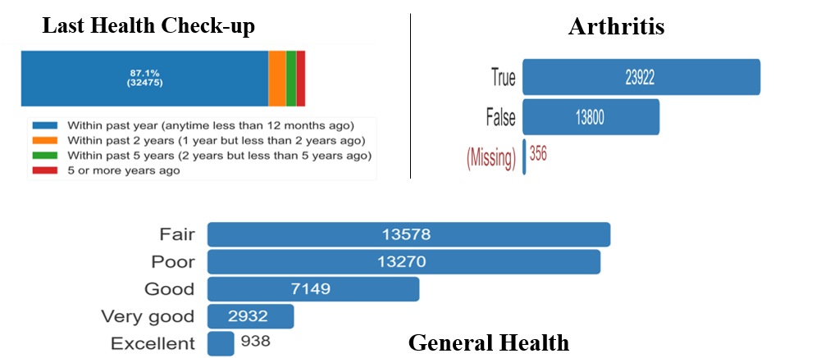
Detail Analysis of Outliers and Inferences
Poor Physical Health
Last Health Check-up:
The majority of respondents (87.1%) had their last health check-up within the past year.
A smaller percentage had their check-up within the past 2 years or 5 years.
A notable portion had their last check-up 5 or more years ago.
Arthritis:
The data shows the number of respondents who reported having arthritis (True) versus those who did not (False).
There is also a category for missing responses.
General Health:
The general health of respondents is categorized into different conditions: Fair, Poor, Good, Very Good, and Excellent.
The majority of respondents reported their health as Fair or Good, with fewer reporting Excellent health.

Slide 12
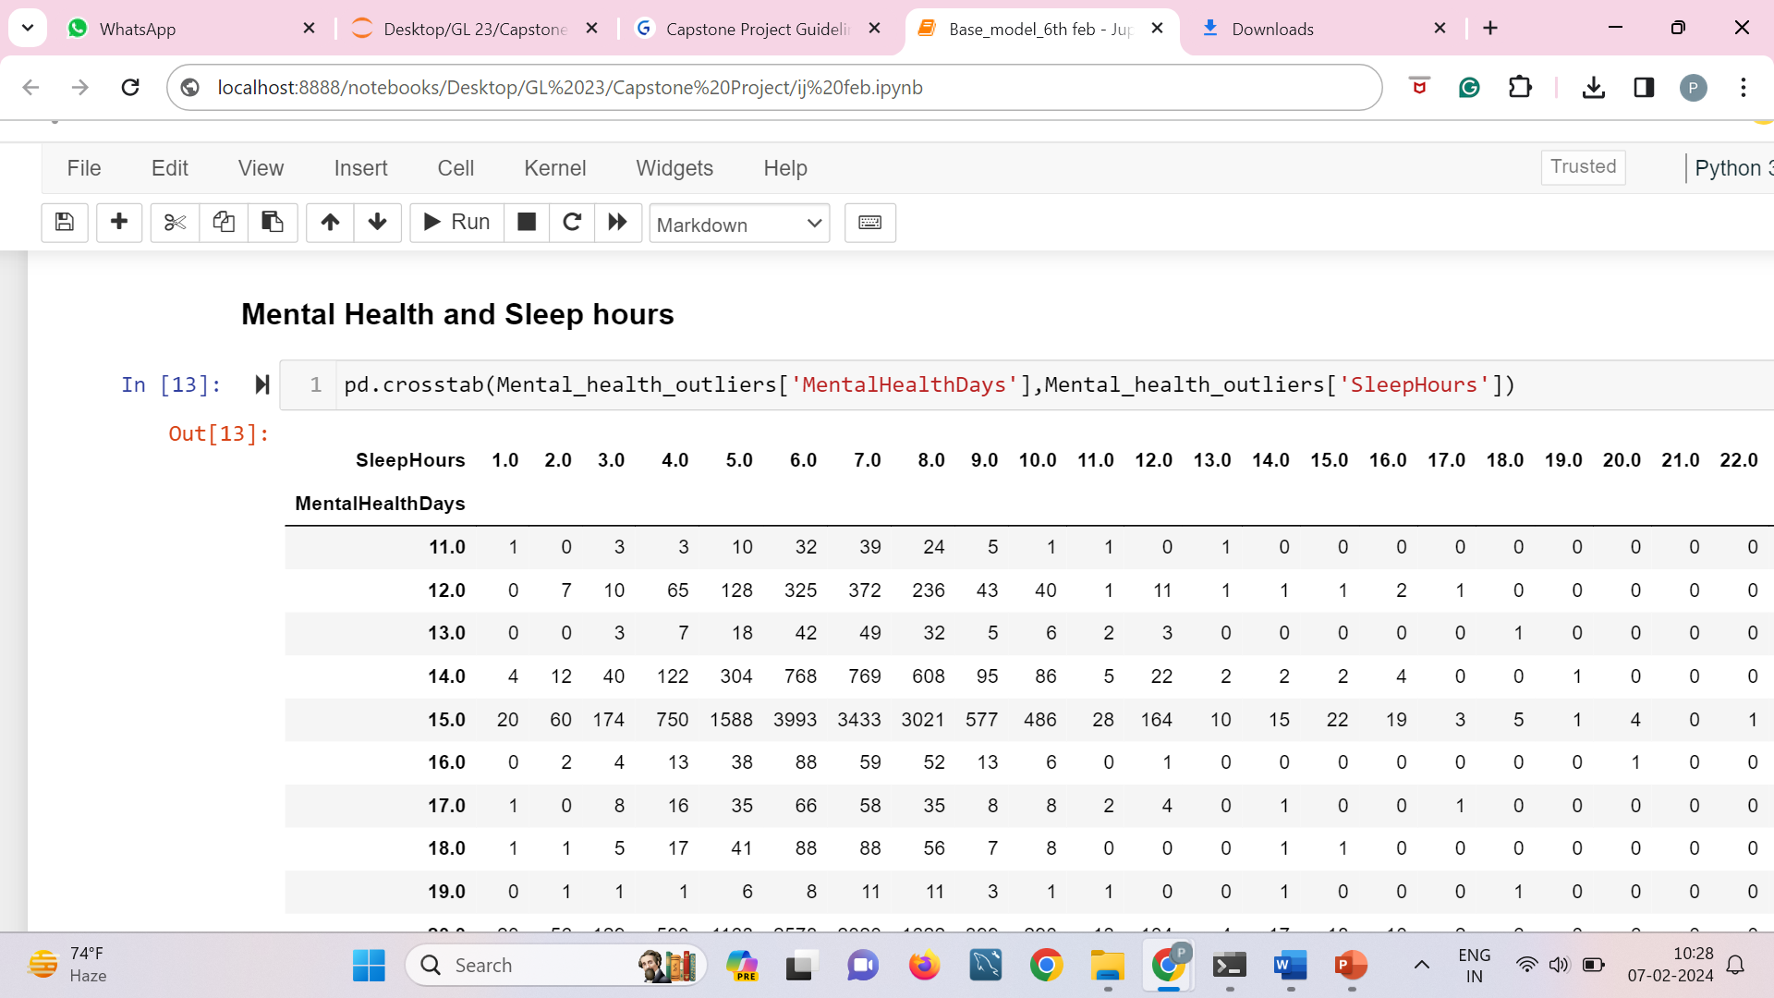
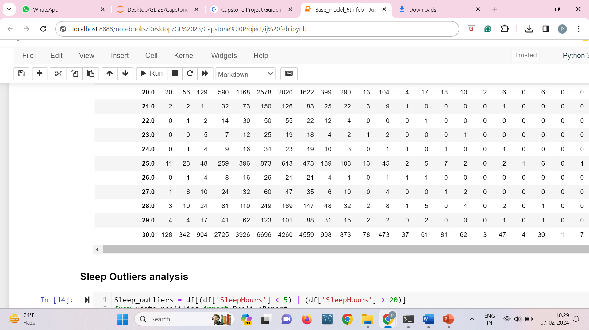
Mental Health
Outliers showed that people with poor mental health 51.8% had depressive disorders.
Last health check up is mostly within last 1 year.
Those with more mental health days are sleeping for less hours.

Slide 13
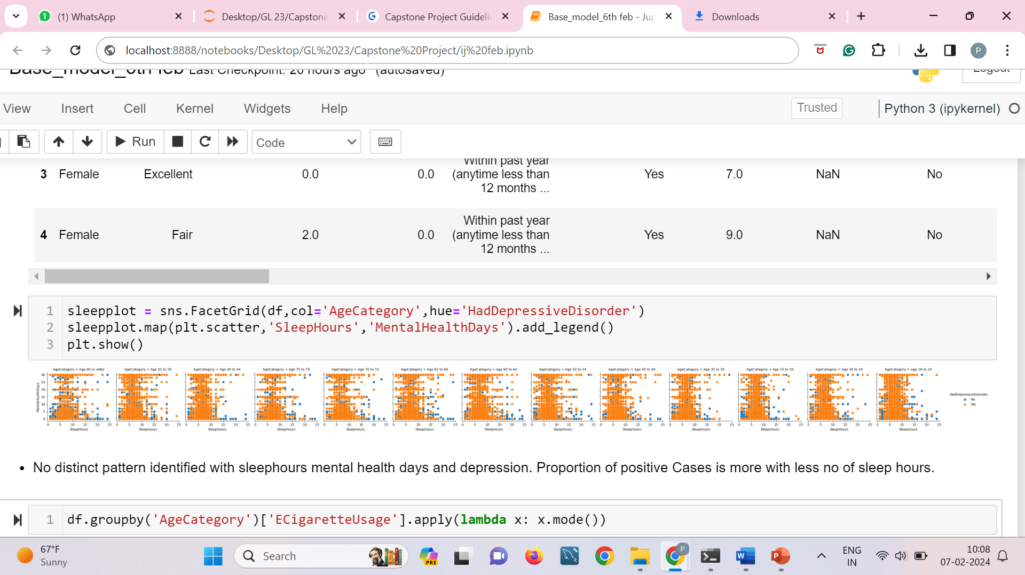
Sleep
Few number of outliers at higher end (above 20) compared to lower end (below 5).
Last Check up time within last 1 year is high. Compared to other physical comorbidities more number of people had depressive disorders around 39.7%.
Among these 47.3% are having arthritis. 34.5% have difficulty in walking.
50.1% of them have done Chest-scan suggesting some physical comorbidities.
Detailed analysis with sleep hour 1 (total 1154) shows some or the other physical or mental comorbidities.
At 24 hours sleep few people do not show significant pattern.

Slide 14
Outliers - Height, Weight and BMI
As per US statistics report by CDC (2020) and Forbes prevalence of obesity in US is high - 41-45%
This justifies median and mean values for weight and BMI
Small proportion of population showing high outliers.
e.g.
BMI>45 → 8805 Observation – arthritis, chest scan, poor general heath is common among them.
Weight > 150 kg → 3378 records, > 250 → 34 records
Cannot obtain clarification
Try Model dropping/ capping higher end outliers.

Slide 15
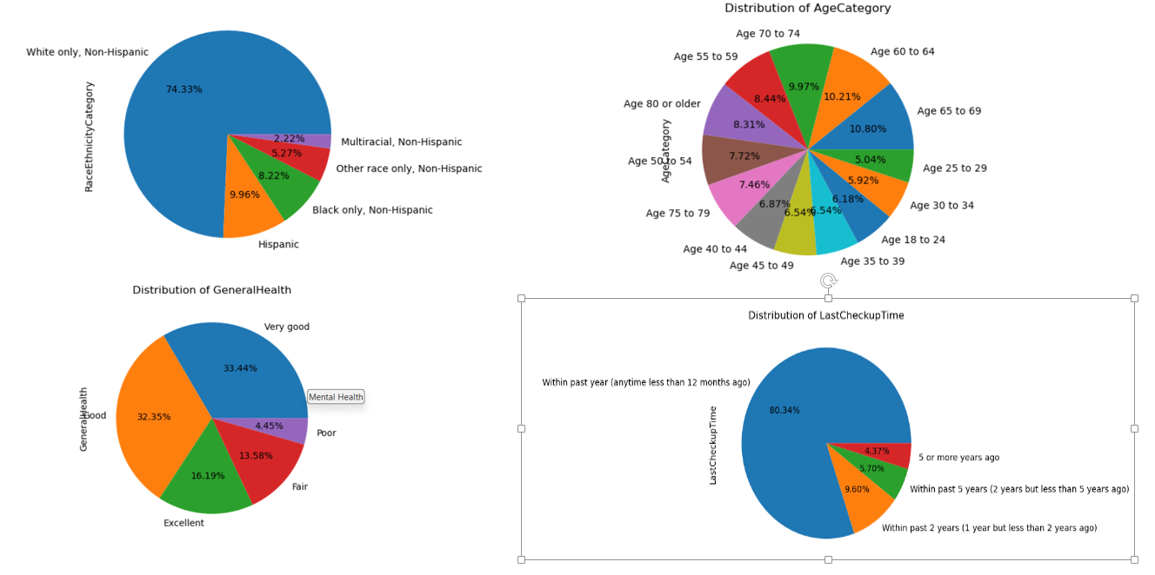
White Only, Non-Hispanic:
This pie chart shows the percentage distribution of health conditions among the White only, Non-Hispanic population.
The majority (74.33%) fall into this category, with smaller percentages for other health conditions.
Age Distribution:
This pie chart illustrates the age distribution of the surveyed population.
The largest age group is 55 to 59 years (10.80%), followed by 60 to 64 years (10.21%).
General Health:
This pie chart shows the distribution of general health status among respondents.
Categories range from Excellent to Poor, with the highest percentage reporting Very Good health (32.35%).

Slide 16
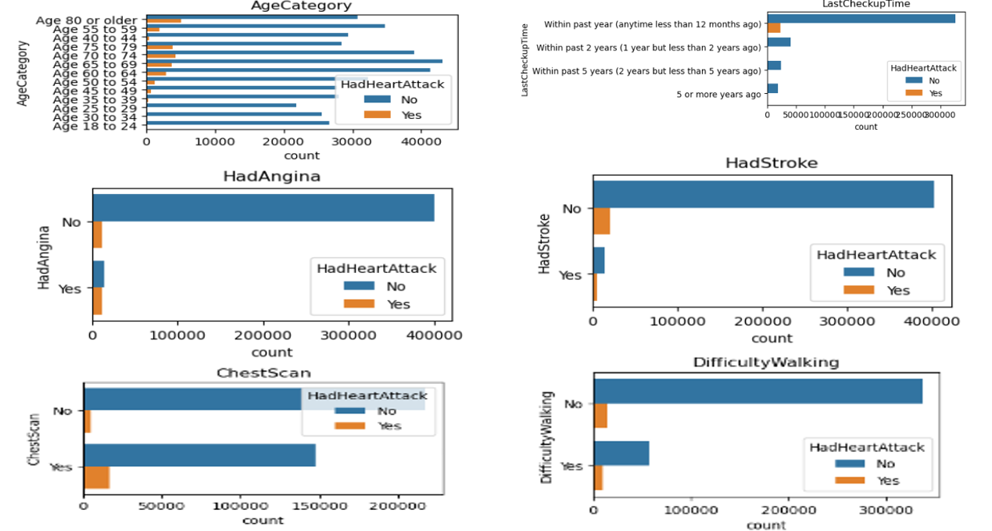
Bivariate Analysis
Heart Attack:
The “HadHeartAttack” graph displays the number of respondents who have had a heart attack (Yes) versus those who have not (No).
Stroke:
The “HadStroke” graph indicates the count of individuals who have had a stroke (Yes) compared to those who have not (No).

Slide 17
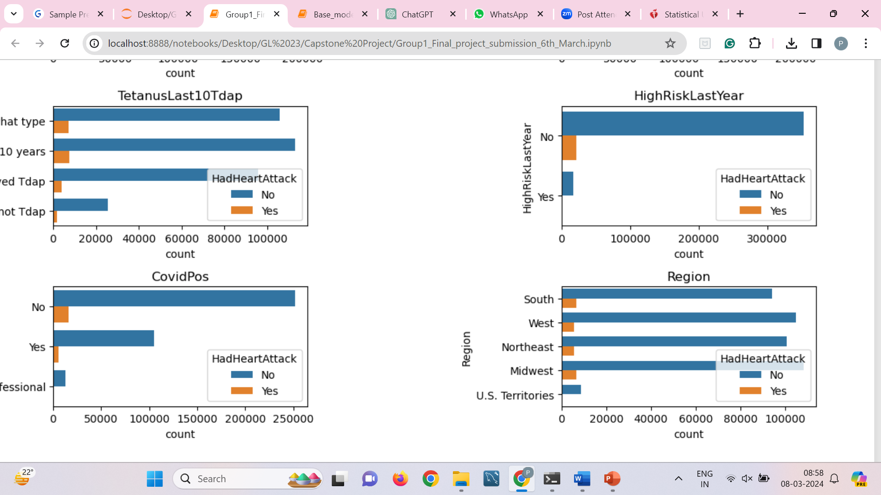
Statistical tests :
Chi-square for Categorical columns
Shapiro test – Data not normal.
Mann Whitney for Numeric Vs Target.
Columns Sleep hours and Mental Health Days had high p values.
Feature Engineering
State to Region ( 54 unique States → 5 Regions)
BMI calculated from Height and Weight – Initially, Later tried KNN imputations, Finally filled by median.
Covid Status reduced to 2 Categories

Slide 18
Missing value Treatment
Dropping rows where Target is null.
Tried KNN Imputer/ Median for missing values in height and weight.
BMI is recalculate after height and weight missing value imputations.
This shifted the max values in BMI introducing more outliers. So KNN and median imputations tried. Finally Median imputations done.
For categorical variables we tried to establish relationship with other variables. Eg – Smoking with age, gender.
As no pattern identified we used Simple imputer for missing values in categorical columns where more than 2 classes were present.
For remaining columns filling of missing values done by model building with Random Forest classifier.
The remaining small amount of null values has been filled using mode imputation.

Slide 19
Encoding
Worked with Ordinal and dummy encoding, WOE encoding.
Final Model by Weight of Evidence categorical encoder.
WOE is a measure of the strength of a relationship between a predictive variable (e.g., a categorical variable) and a binary target variable.
It also reduces dimensionality
Transformation
After assessing the skewness of the numeric variables, we applied various transformations to address the non-normal distribution.
The skewness of the BMI variable was found to be 1.51 → Box-Cox Transformation
PhysicalHealthDays → log1p

Slide 20
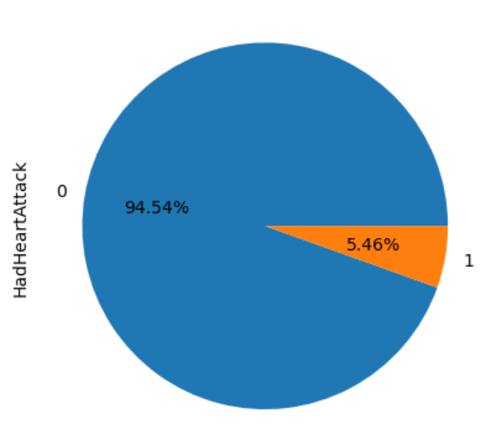
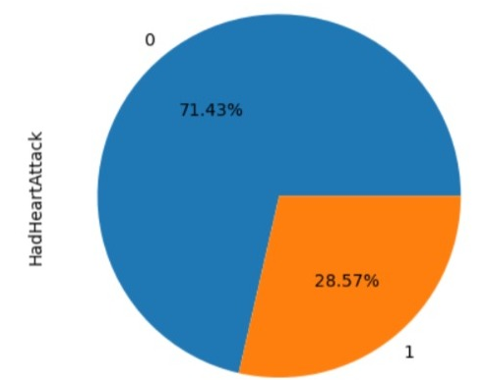
Class Imbalance
Before Smote
After Smote
Initial Models built without SMOTE.
Further SMOTE resampling for target variable was done on training data. We tried different SMOTE strategies 0.2,0.3,0.4
Most effective model achieved at SMOTE 0.4 with k neighbours 10.

Slide 21
Model Building
Different EDA and Models tried are as follows : --
Tried Models after dropping null values
Capping outliers
Different encoding strategies – ordinal and dummy, WOE
Various null value treatments – finding associations among Xs, imputing by model,
Combination of models, simple imputer and mode-
Recalculate BMI by imputing missing values in height and BMI-
Imputing BMI by KNN
Imputing BMI by median
Model with Transformation
Model without transformation
Preprocessing separated for train and test data.

Slide 22
Model Building
Models by dropping null values:
After performing data preprocessing, we built the first base model (Logistic Regression) on imbalanced data. The performance metrics were a recall of 25% and an accuracy score of 95%.
After applying SMOTE to address the imbalanced data, we again built the Logistic Regression base model and got a increase in performance metrics were a recall of 60% and accuracy score of 92%
As the performance metrics scores were very low for the unseen (test) data, we tried different combinations of hyperparameters using RandomizedSearchCV that yielded the best model performance. We then built different models with fine-tuned hyperparameters such as
Decision Tree : recall of 46 and an accuracy score of 93%
Random Forest Classifier : recall of 46 and an accuracy score of 93%
XG Boost : recall of 94 and an accuracy score of 56%

Slide 23
Models after null value treatment:
By dropping null values, we did not obtain the best model.
Consequently, we built a model by filling the null values. Once again, we constructed a Logistic Regression model on imbalanced data and obtained a similar score, with a recall of 24% and an accuracy of 95%.
After applying SMOTE to address the imbalanced data, we once again constructed the Logistic Regression base model. There was a noticeable increase in performance metrics, with a recall of 58% and an accuracy score of 91%.
However, since the recall value remained relatively low for the test data, we proceeded to explore different combinations of hyperparameters and built various models with fine-tuned parameters:
Decision Tree: Achieved a recall of 41% and an accuracy score of 92%.
Random Forest Classifier: Demonstrated a recall of 34% and an accuracy score of 94%.
XG Boost: Showcased a recall of 71% and an accuracy score of 85%.

Slide 24
After extracting the best features from the XGBoost model using feature importance,we constructed a new model specifically on these important features. This resulted in a recall of 71% and an accuracy score of 85%.
After applying a sequential feature selector (SFS) on XGBoost, 21 important features were identified. Subsequently, various models were built on this reduced set of features using SFS, yielding the following results:
Decision Tree: Achieved a recall of 37% and an accuracy of 93%.
Random Forest Classifier: Demonstrated a recall of 40% and an accuracy of 94%.
AdaBoost : Showcased a recall of 29% and an accuracy of 94%.
XGBoost : Maintained a recall of 71% and an accuracy of 85%.

Slide 25
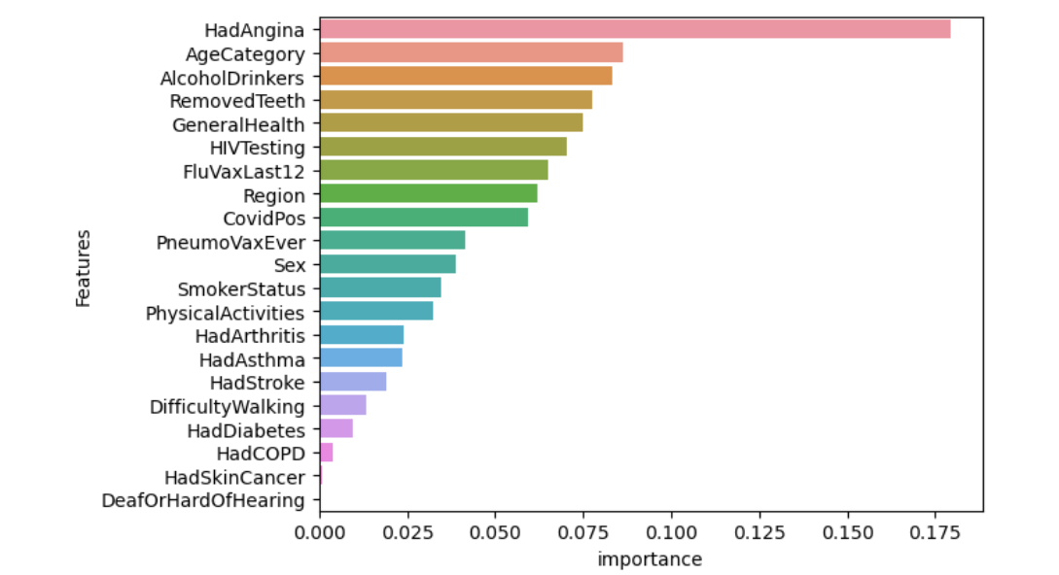
Sequential Feature Selection
AlcoholDrinkers: The impact of alcohol consumption on health.
SmokerStatus: Smoking status and its correlation with health conditions.
PhysicalActivities: The role of physical activity in maintaining health.
HadDiabetes, HadCOPD, HadStroke: Specific health conditions and their importance in the analysis.
DifficultyWalking: Mobility issues and their significance.

Slide 26
Further feature importance analysis on the new XGBoost model from SFS revealed that the features 'Hadskincancer' and 'DeaforHardofHearing' had zero importances. As a result, these features were dropped, and a new model was built on the remaining features. The updated model achieved a recall of 70% and an accuracy of 86%.
It's noteworthy that dropping columns led to a reduction in both accuracy and recall, prompting the decision to retain the final set of 21 features for predictions. This suggests that, despite the initial insignificance of 'Hadskincancer' and 'DeaforHardofHearing' in terms of feature importance, their inclusion contributes to the overall predictive performance of the model.

Slide 27
Final Best Model:
After trying various models, the best-performing model we obtained was the full XGBoost model, achieving an accuracy of 0.85 on the test dataset and an accuracy of 0.88 on train dataset.
Similarly, the recall for positive cases improved significantly to 0.71 on test, indicating better detection of actual positive cases. dataset and 0.94 on train dataset
The AUC score reached an impressive value of 0.8757, indicating superior discrimination between positive and negative cases in the test dataset.

Slide 28
After applying sequential feature selection, the “Gaussian Naive Bayes” model emerged as the top-performing model, achieving an accuracy of 0.83 on the test dataset and an accuracy of 0.81 on train dataset.
Similarly, the recall for positive cases improved significantly to 0.73 on test and 0.74 on train dataset. These results suggest an improved capability of the model to identify actual positive cases, reducing the chances of false negatives.
The AUC score reached an impressive value of 0.8675, indicating superior discrimination between positive and negative cases in the test dataset, underlining its effectiveness in making accurate predictions

Slide 29
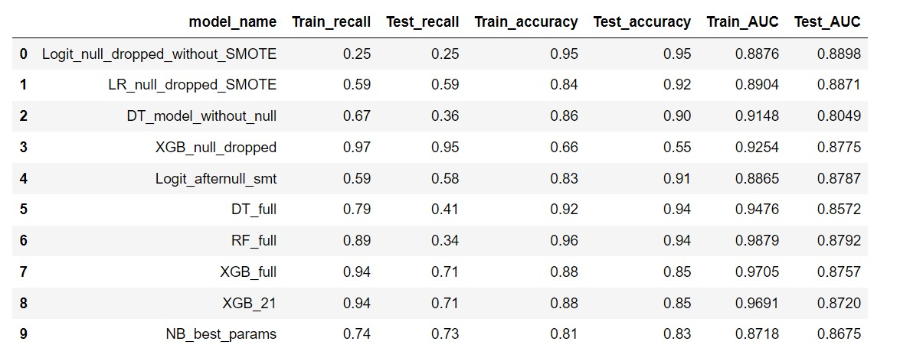
Summary Table for Model Performance

Slide 30
ROC PLOT
Let us look at ROC plot
Interpretation:
Models with higher AUC values generally have better performance in terms of classification.
Models with AUC values closer to 1.0 demonstrate better separation between classes.
And Models with AUC values closer to 0.5 suggest poor discrimination ability and might perform similarly to random guessing.
Comparative Analysis:
For instance, the “Logit_full" model has the highest AUC scores among all models, indicating excellent discrimination ability both on the training and testing sets.
We cannot use Logit though initial performance good- bcoz there are strongly influencing outliers, pseudo R2 is low 0.3 something
A value of 0.3 indicates a moderate level of explanatory power, meaning that the independent variables in the model collectively explain around 30% of the variability in the dependent variable.

Slide 31
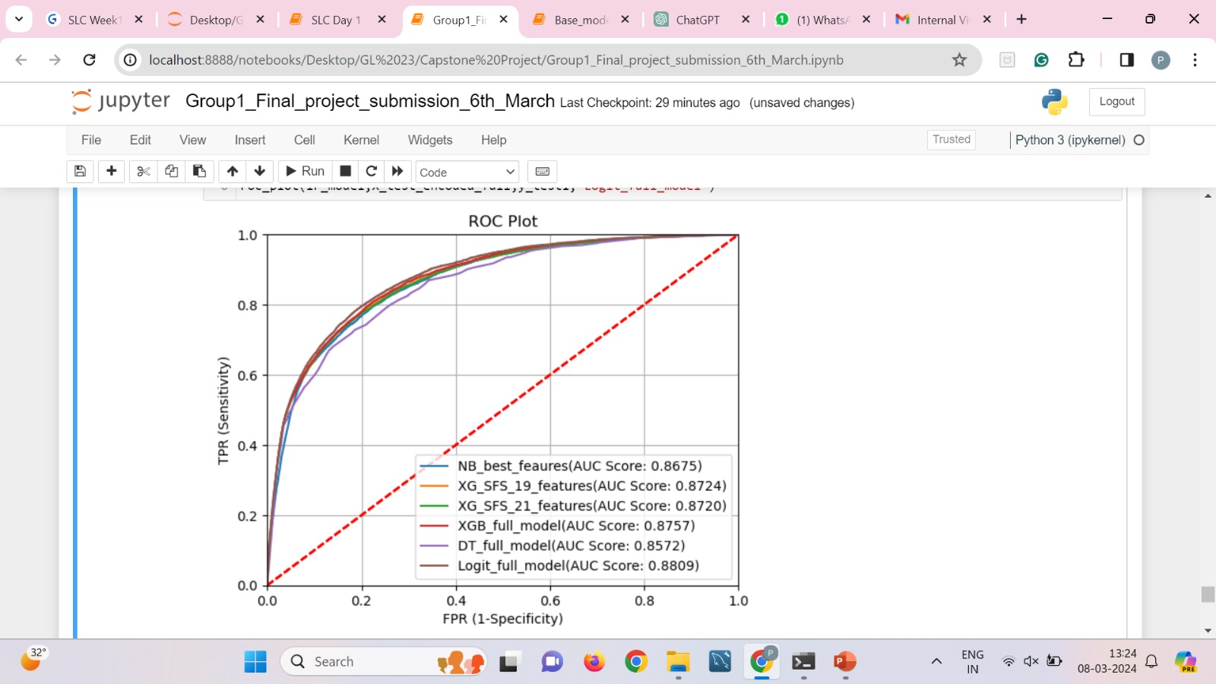
Also NB_best_features shows best roc best assumptions are not met
Conditional independence: All variable values are conditionally independent, given the target classification. This assumption reduces the complexity of calculations.
Conversely, the “dt_full" model shows relatively lower AUC scores, implying weaker discrimination performance compared to other models.
Nb model and xgb full
xgb best params is xgb 21
In summary, the ROC metrics provide valuable insights into the discriminatory power of the models, helping to evaluate their performance in classifying instances into positive and negative classes

Slide 32
Deriving Business Metrics and Business Insights
Business Metrics:
Accuracy: XGB_sfs_21 achieves 85% accuracy in predicting heart attack risk.
Recall Rate: The model identifies 71% of individuals with heart attacks.
AUC Score: XGB_sfs_21 demonstrates a strong AUC of 0.8720.
Cost Savings: Estimate potential cost reductions through targeted interventions.
Patient Outcomes: Assess impact on reduced heart attack incidence and improved health outcomes.
Business Insights:
Identifying High-Risk Individuals: XGB_sfs_21 enables proactive interventions.
Understanding Risk Factors: Gain insights into key predictors for tailored interventions.
Resource Allocation: Efficiently allocate healthcare resources.
Tailored Interventions: Design personalized treatment plans.

Slide 33
Business Metrics:
Prediction Accuracy: XGB_sfs_21 demonstrated a test accuracy of 0.85, indicating that it correctly predicts heart attack risk for 85% of individuals in the test dataset.
We calculate this by calculating the ratio of correct predictions to the total number of input Samples.
Recall Rate: With a test recall of 0.71, the model identifies 71% of individuals who had a heart attack, enabling targeted interventions for high-risk individuals.
Out of all actual positive cases, how many were correctly predicted by the model?"
AUC Score: The model achieves a test AUC of 0.8720, indicating strong discriminatory power in distinguishing between individuals with and without heart attacks.
Cost Savings: Estimate potential cost savings in healthcare expenditures through targeted preventive interventions for individuals identified as high-risk by the model, reducing healthcare costs associated with heart-related conditions.
Patient Outcomes: Assessing the impact of the model on patient outcomes, including reduced incidence of heart attacks, improved management of cardiovascular risk factors, and enhanced overall health outcomes.
Business Insights:
Identifying High-Risk Individuals: XGB_sfs_21 identifies individuals at elevated risk of experiencing a heart attack based on their demographic, clinical, and lifestyle characteristics, enabling proactive interventions and personalized healthcare management.
Understanding Risk Factors: Gain insights into the primary predictors contributing to heart attack risk, such as age, BMI, smoking status, chronic conditions, and previous medical history, guiding targeted interventions and risk mitigation strategies.
Optimizing Resource Allocation: Allocate healthcare resources more efficiently by focusing on high-risk individuals identified by the model, prioritizing preventive care, early interventions, and health promotion efforts to improve population health outcomes.
Tailored Interventions: Design personalized interventions and treatment plans tailored to individuals' risk profiles, incorporating evidence-based practices, behavioral interventions, and lifestyle modifications to reduce cardiovascular risk and improve overall health outcomes.

Slide 34
Output
The minimum age to have a heart disease start from 28 years old.
Most of the people get heart disease at the age of 53 to 54 years.
Most of the males and females get are with heart disease at the age of 54 to 55 years.
Male percentage i the data: 78.91%
Female percentage in the data : 21.09%
Males are 274.23% more than female in the data.
***..Age vs Sex and origin..***
The highest number of female in this dataset are from Cleveland(97) and lowest are from VA Long Beach(6).
The highest number of male are from Hungary(212) and lowest from Switzerland(113).
***..Chest pain according to Origins..***
The high number of Typical angina, Asymptomatic and Non angina chest pain is in the Cleveland while Atypical anigna is highly occured in Hungary.
Lowest number of chest pain (Typical angina, Asymptomatic, Non angina and Atypical angina)is happened in Switzerland as compare to other origins.
***..Chest pain according to Age..***
The highest number of chest pain is happened is Asymptomatic Angina and the lowest number of cp is that happened is Typical Angina.
The age in which highest number of Typical Angina happened is 62 to 63 years.
The age in which highest number of Asymptomatic Angina happened is 56 to 57 years.
The age in which highest number of Non Anginal happened is 54 to 55 years.
The age in which highest number of Atypical Angina happened is 54 to 55 years.

Slide 35
Future Steps
Feature Engineering: Create new features or transform existing ones to capture more information.
Model Ensemble: Combine predictions from multiple models for better performance. Use stacking models, voting classifiers etc.
Advanced Hyperparameter Tuning: Use sophisticated techniques to optimize model parameters efficiently.
Data Augmentation: Increase dataset diversity and size through augmentation techniques.
Continuous Model Monitoring: Implement a system for ongoing model evaluation and retraining.
Adding More Important Features: Identify and include additional crucial features that may have been overlooked initially.

Slide 36
Conclusion
Through the process of analyzing the "Indicators of Heart Disease (2022 UPDATE)" dataset and building a predictive model for heart attack risk, we have gained valuable insights and learned important lessons.
We recognize the importance of thorough exploratory data analysis, robust preprocessing techniques, and careful model evaluation in developing effective machine learning solutions for healthcare.
Overall, the project has been a valuable learning experience, providing us with the opportunity to contribute to improving heart disease risk assessment and management.

